Slide 1
Air Accidents in LATAM
By HAMM

Slide 2
Problems with this accidents
Tourism
Economy
Fear
Airplane Companies

Slide 3
Hypotesis
The accidents in the region are provided for the geographic accidents more than the political and economical features

Slide 4
Geographical accidents
Andes mountains
The argentinian pampa
Gran chaco
Patagonian desert
Fire land

Slide 5
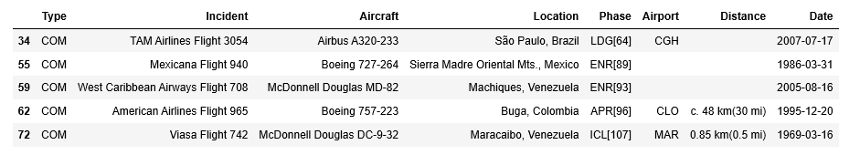
Five air accidents in the region

Slide 6
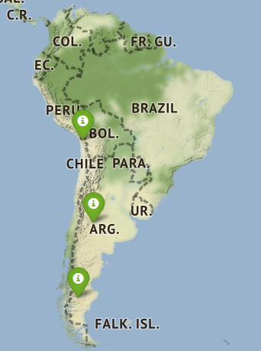
Map of important geographical accidents

Slide 7
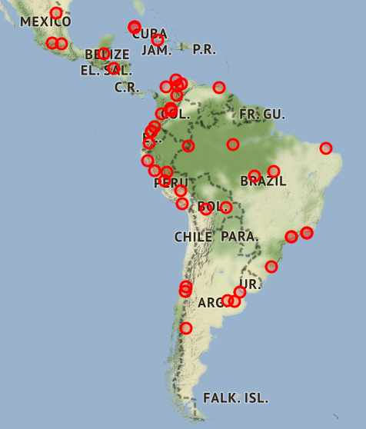
Map of the accidents

Slide 8
Conclusion
To conclude the work we find that geographical failures are the cause of most of the aerial tragedies in Latin America. Although we all know that the region is not only difficult because of geography but also because of political, social and forced displacement situations.
We found that most of the accidents occurred in the north of his America since there are the high winds, winds that come from the Pacific and the mountains are much more difficult to travel.

